Slide 1

ZOMATO ANALYSIS (P778)
RUDANT KADAM (group1)

Slide 2
Overview of the Dataset:
“ The data is compiles of76,408 restaurants across 15 countries and 141 cities, covering a total of 1,825 unique cuisines and nearly 12 million votes from customers. These insights provide a comprehensive look into the restaurant industry’s global landscape."

Slide 3
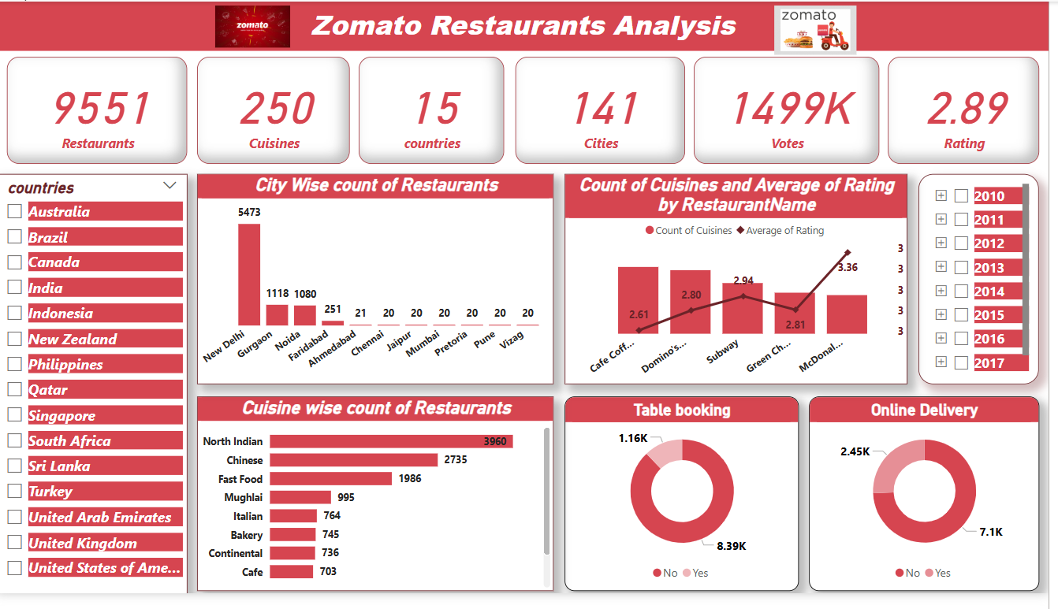
POWERBI DASHBOARD

Slide 4
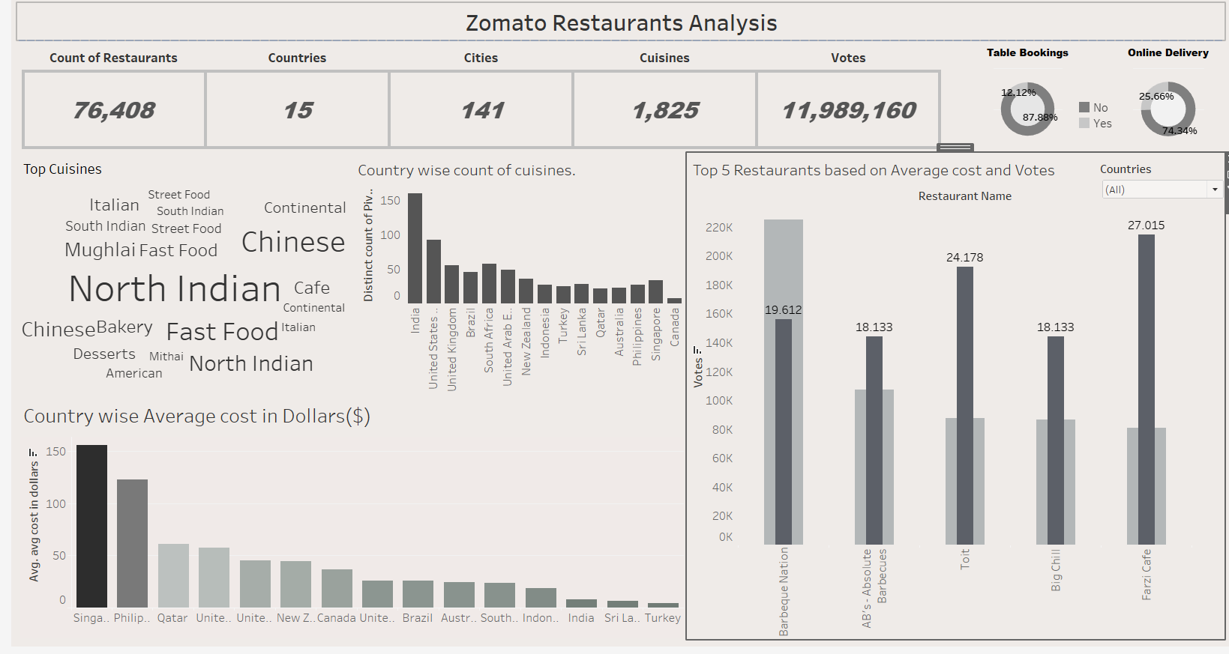
TABLEAU DASHBOARD

Slide 5
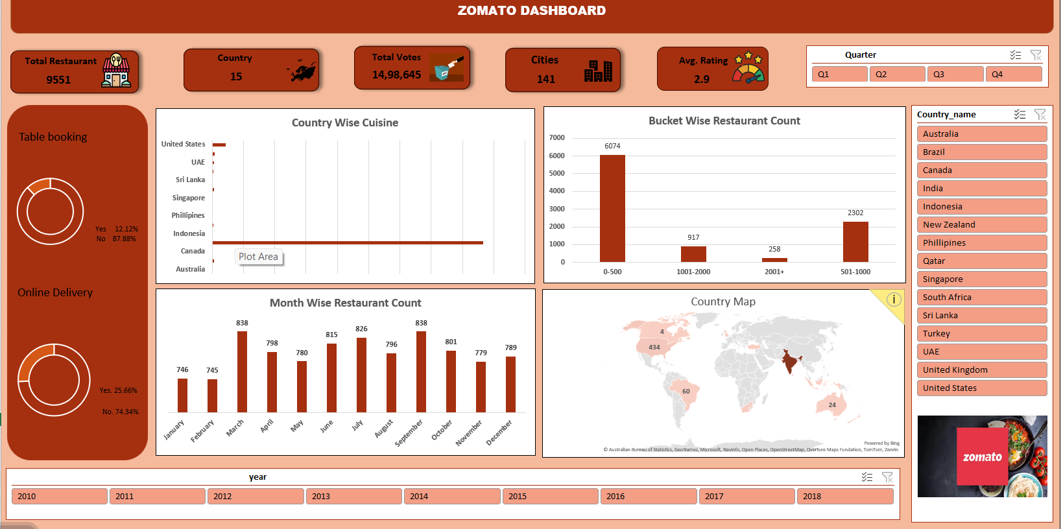
EXCEL DASHBOARD

Slide 6
Business Implications & Decision-Making:
"These insights allow businesses to identify high-performing cuisines, set competitive pricing, and improve service offerings. For instance, restaurants in regions with lower online delivery adoption may consider expanding their digital services to enhance customer reach."

Slide 7
Conclusion:
"In summary, this dashboard provides a data-driven approach to understanding restaurant industry trends, customer preferences, and pricing strategies. Leveraging these insights can help businesses refine their market strategies and improve customer satisfaction."

Slide 8

This Photo by Unknown Author is licensed under CC BY-SA

